Slide 1
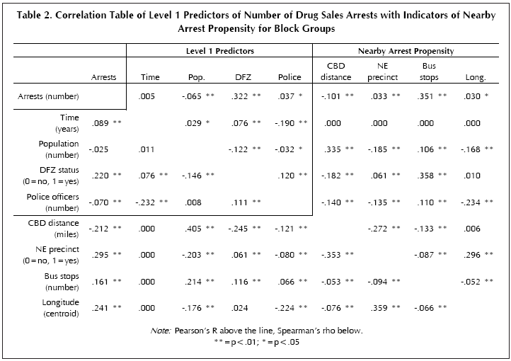
Week 10:Writing about numbers; Correlation & ANOVA
Geog4300: Shannon

Slide 2

Writing about numbers
“In many ways, writing about numbers is similar to other kinds of expository writing: it should be clear, concise, and written in a logical order. It should start by stating an idea or proposition, then provide evidence to support that thesis. It should include examples that the expected audience can relate to, and descriptive language that enhances their understanding of how the evidence relates to the question[….] In short, it will follow many of the principles of good writing, but with the addition of quantitative information.” (p. 2)
Notes:
Alternative hypothesis is usually what you’re trying to prove.

Slide 3
Principle 1: The W’s
Who, what, when, and where
Bad: “There were 25 million deaths.”
Better: “During the fourteenth century, 25 million people died in Europe.”
Best: “When the Black Plague hit Europe in the latter half of the fourteenth century, it took the lives of 25 million people, young and old, city dwellers and those living in the countryside. The disease killed about one-quarter of Europe's total population at the time (Mack, n.d.).”
Notes:
Alternative hypothesis is usually what you’re trying to prove.

Slide 4
Principle 2: Picking simple, plausible examples
Bad: “In 2001, the average temperature in the New York City area was 56.3 degrees Fahrenheit.”
Better: “In 2001, the average temperature in the New York City area was 56.3 degrees Fahrenheit, 1.5 degrees above normal.”
Best: “In 2001, the average temperature in the New York City area was 56.3 degrees Fahrenheit, 1.5 degrees above normal, making it the seventh warmest year on record for the area.”
Notes:
Alternative hypothesis is usually what you’re trying to prove.

Slide 5
Principle 3: Defining & interpreting your terms
“Those who are not familiar with your topic are unlikely to know which comparisons to make or to have the information for those comparisons immediately at hand. To help them grasp the meaning of the numbers you report, provide the relevant data and explain the comparisons.”
Bad: “In 2011, total expenditures on health care in the United States were estimated to be more than $2.7 trillion (Centers for Medicare and Medicaid Services 2013).”
Best: “Between 2000 and 2011, the total costs of health care in the United States nearly doubled, from $1,377 billion to $2,693 billion (Centers for Medicare and Medicaid Services 2013; table 1). Over that same period, the share of gross domestic product (GDP) spent for health care increased from 13.7% to 17.7% (Organisation for Economic Cooperation and Development [OECD]2013, figure 7.2.2).”
Notes:
Alternative hypothesis is usually what you’re trying to prove.

Slide 6
Principle 7: Summarizing patterns
“However, if you provide only a table or chart, you leave it to your readers to figure out for themselves what that evidence says. Instead, digest the patterns to help readers see the general relationship in the table or chart.”
Example: “As shown in figure 2.1, the median price of a new single-family home followed a general upward trend in each of the four major census regions between 1980 and 2000. This trend was interrupted by a leveling off or even a decline in prices around 1990, after which prices resumed their upward trajectory. Throughout most of the period shown, the highest housing prices were found in the Northeast, followed by the West, Midwest, and South (US Census Bureau 2001a).”
Note exceptions: “In three of the four regions, housing prices rose throughout the 1980s. In the South, however, housing prices did not begin to rise until 1990, after which they rose at approximately the same rate as in each of the other regions.”
Notes:
Alternative hypothesis is usually what you’re trying to prove.

Slide 7
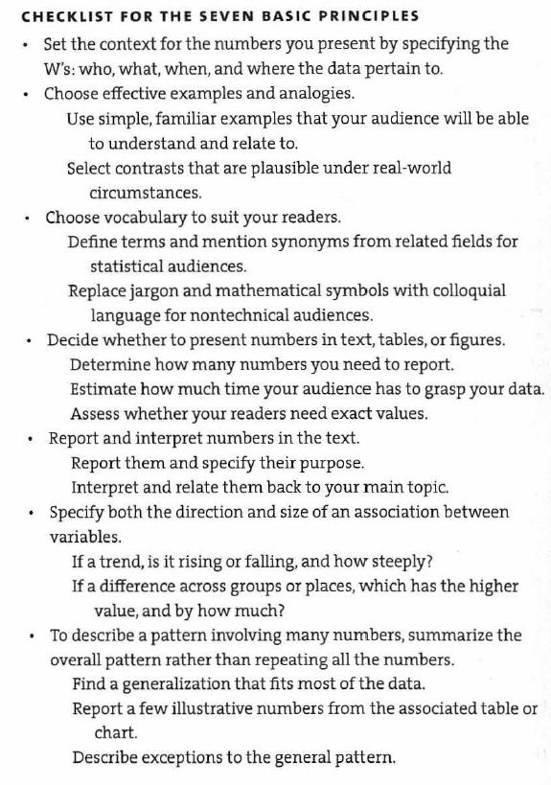
Notes:
Alternative hypothesis is usually what you’re trying to prove.

Slide 8
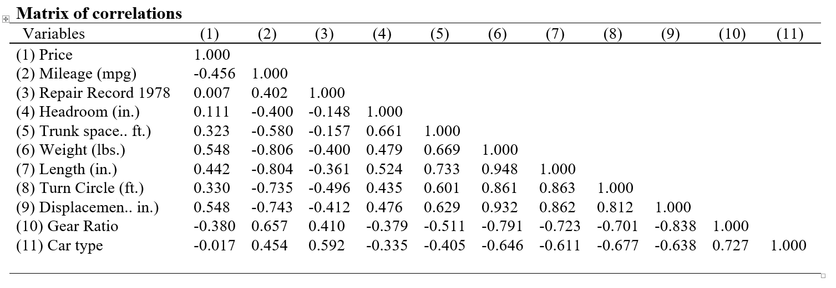
Correlation
How do variables co-vary with one another?
https://fintechprofessor.com/2018/03/05/export-high-quality-table-correlations-stata-ms-word/
Notes:
Alternative hypothesis is usually what you’re trying to prove.

Slide 9
Correlation
Correlation is NOT causation
Correlation is challenging to write about—so many numbers!
https://fintechprofessor.com/2018/03/05/export-high-quality-table-correlations-stata-ms-word/
Notes:
Alternative hypothesis is usually what you’re trying to prove.

Slide 10
Summarizing patterns
What trends do you see in this table? How would you group these variables based on direction and magnitude?
https://fintechprofessor.com/2018/03/05/export-high-quality-table-correlations-stata-ms-word/
Notes:
Alternative hypothesis is usually what you’re trying to prove.

Slide 11
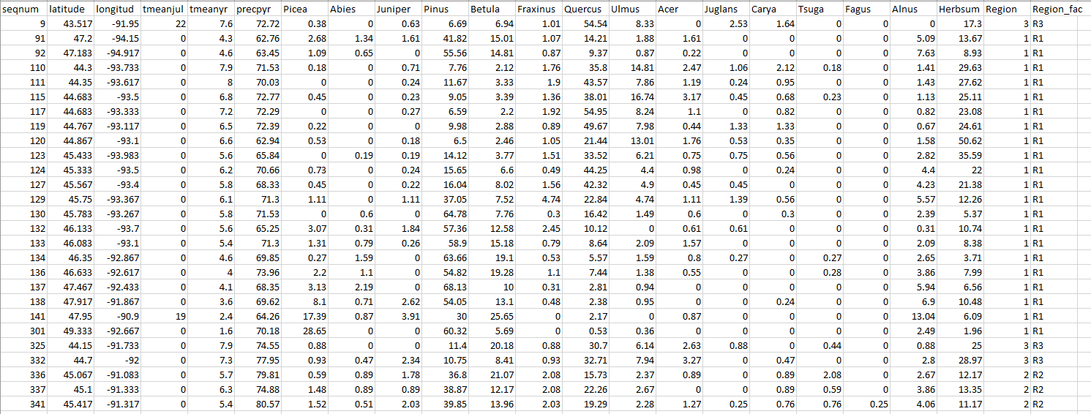
Let’s try it!
Correlation of Midwest pollen data in Excel.
Notes:
Alternative hypothesis is usually what you’re trying to prove.

Slide 12
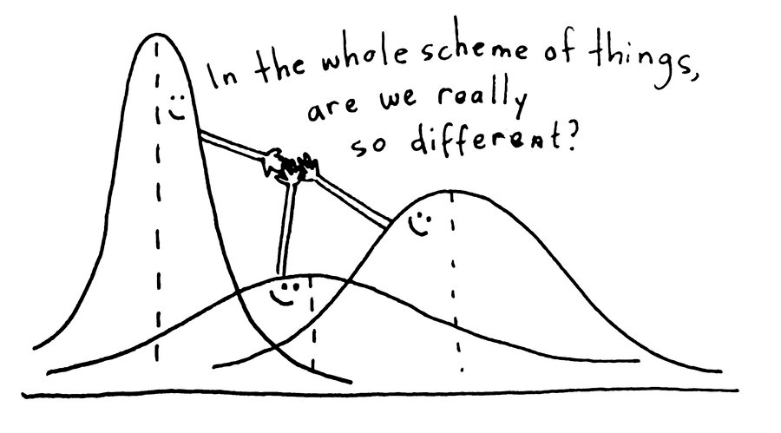
ANOVA: Analysis of Variance
Notes:
Alternative hypothesis is usually what you’re trying to prove.

Slide 13
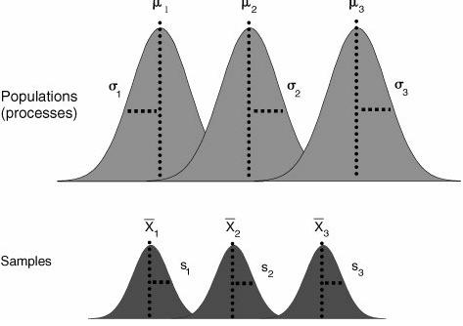
ANOVA: Analysis of Variance
Within group variance
One observation
Between group variance
Mean of ALL observations-
the “grand mean”
Notes:
Alternative hypothesis is usually what you’re trying to prove.

Slide 14
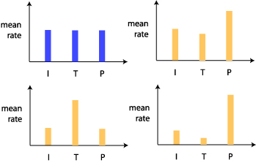
ANOVA: Analysis of Variance
The ANOVA test would be significant in finding a difference for all of these cases except for here
Notes:
Alternative hypothesis is usually what you’re trying to prove.

Slide 15
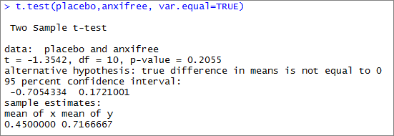
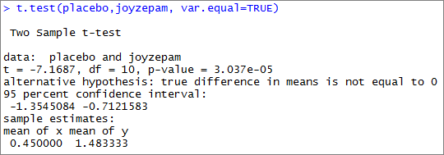
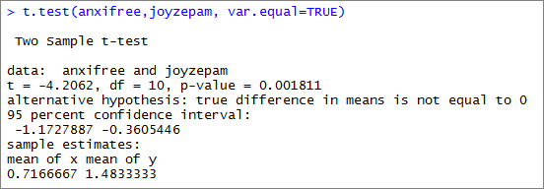
Post-hoc tests
Repeated t-tests between all groups to identify where the difference is.
Notes:
Alternative hypothesis is usually what you’re trying to prove.

Slide 16
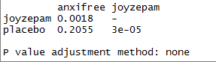
Post-hoc tests
To control for potential false positives, post hoc tests use statistical corrections.
Bonferroni correction:
Multiple the p-value by the number of tests
3 * 0.0018 = 0.0054
3 * 0.2055 = 0.6165
3 * 0.00003 = 0.00009
Notes:
Alternative hypothesis is usually what you’re trying to prove.

Slide 17
Let’s try it!
ANOVA with the Midwest pollen data in Excel.
Notes:
Alternative hypothesis is usually what you’re trying to prove.

Slide 18
Write up your results!
Summarize patterns (and exceptions)
Is there a difference?
Interpret your terminology and results
What does significance mean in an ANOVA test? In a post-hoc test?
Give examples
Note significant differences where they occur
Notes:
Alternative hypothesis is usually what you’re trying to prove.

